Slide 1

Web technologies using java
Course 1 - introduction

Slide 2
agenda
Curriculum
evaluation
The HTTP protocol
HTTPS
web application structure
Web containers
Application servers
servlets

Slide 3






curriculum
1. Web applications intro
2. Spring Core
3. Spring MVC with Spring Boot and Thymeleaf
4. REST APIs with Spring Boot
5. Working with databases using Spring Data JDBC
6. JPA / Hibernate fundamentals
7. Working with databases using Spring Data JPA
8. Working with transactions in Spring
9. Unit tests with Junit and Mockito
10. Integration tests with Spring

Slide 4
curricula
All course materials will be available at:
Github repository

Slide 5
evaluation
Exam: 3 points
Lab: 6 points
Attendance: 1 point
Project: 4 points
Assignments: 1 point
Implicitly granted points: 1 point
NOTES:
Lab attendance point is proportional with the attendance (1 point for 7 attended labs, 0.4 points for 3 attended labs etc)
Exam attendance is mandatory
Exam consists of implementing an application (similar to the one from the lab project)
Exam will take 2 hours
Passing score is obtained after exam points and lab points are summed up

Slide 6
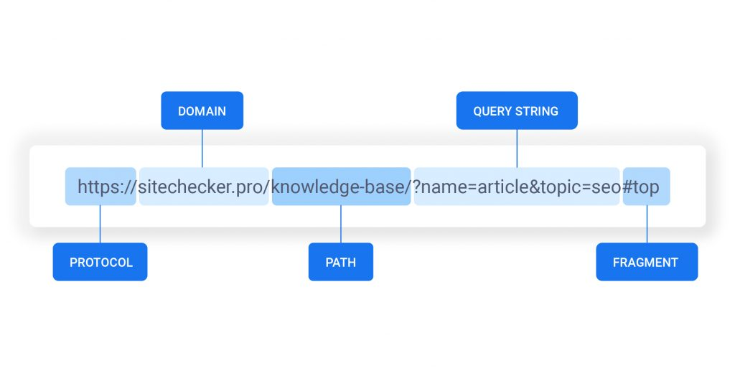
The HTTP protocol
application layer protocol
URI
URL
HTTP methods
HTTP status codes
request
response
Note: Birth of the Web

Slide 7
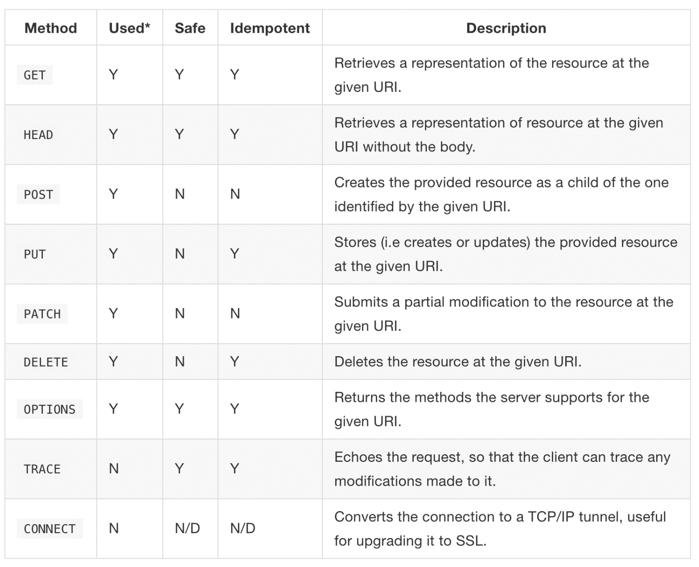
HTTp request methods

Slide 8
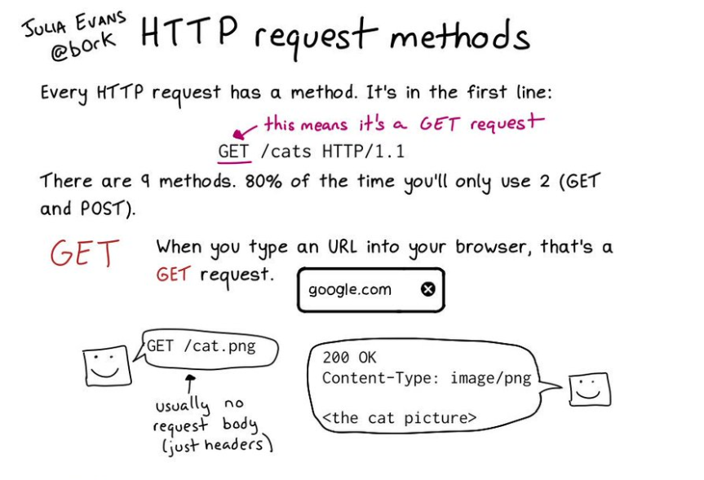
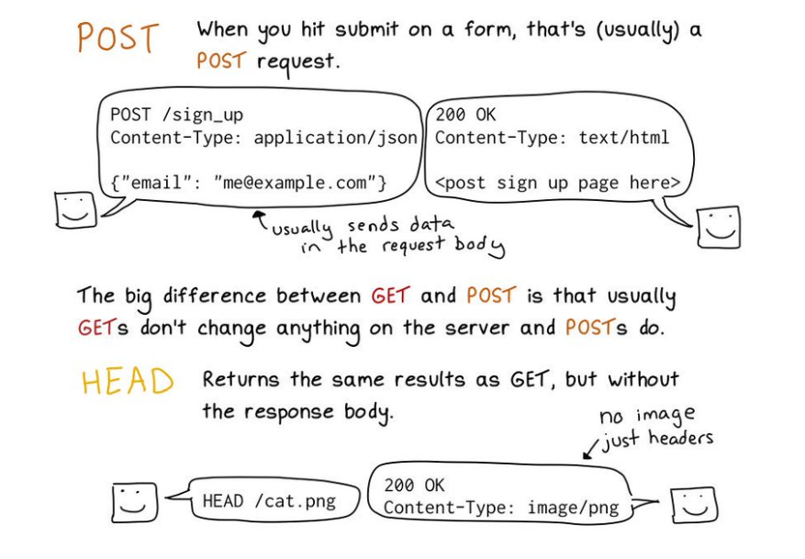
HTTP request methods

Slide 9
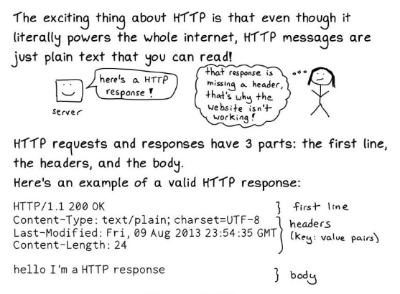
HTTP messages

Slide 10
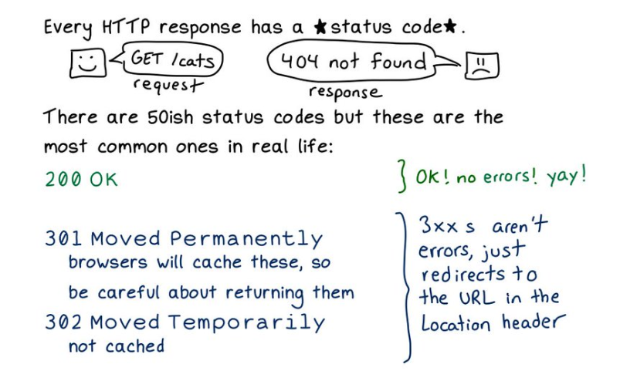
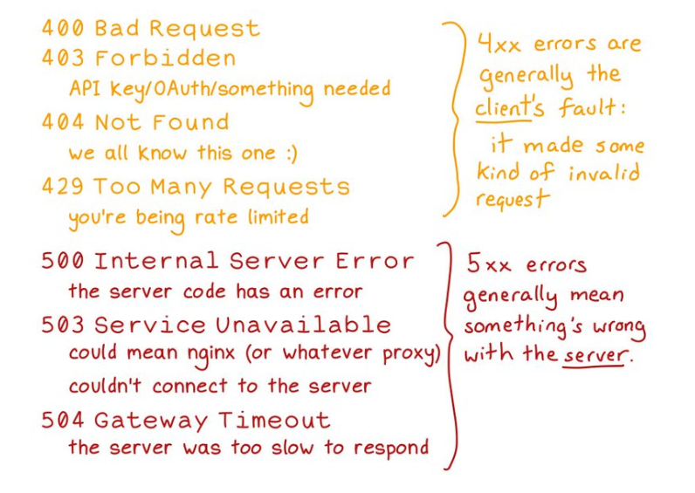
HTTP status codes

Slide 11
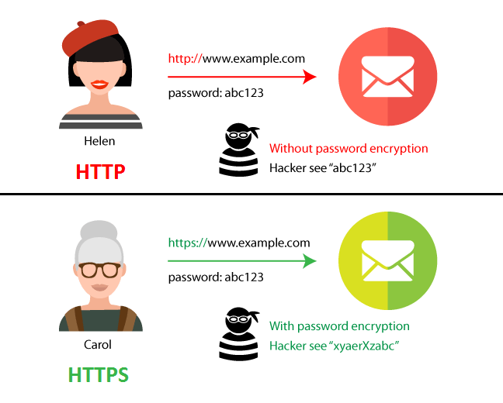
HTTPS
HTTP sent over a secure transport layer (SSL)
all HTTP request and response data is encrypted before being sent across the network
Server certificates

Slide 12
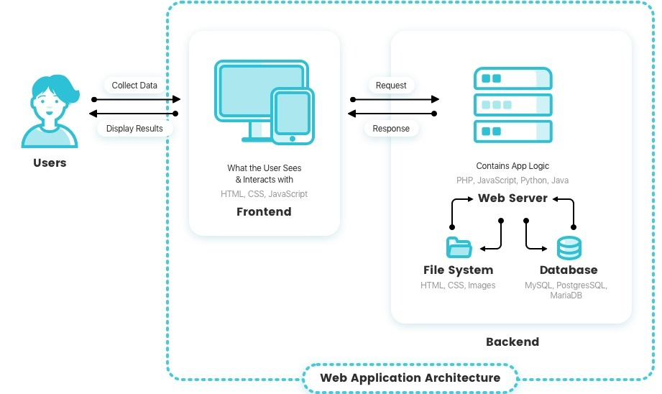
BASIC web application structure

Slide 13
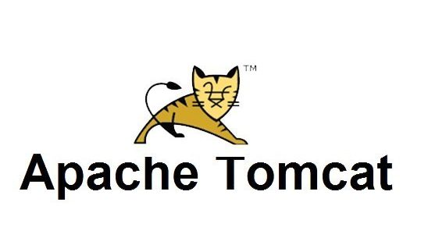
WEB containers
implement only a part of the Java EE specifications
accept and respond to HTTP requests
manage the life cycle of Servlets
map request URLs to Servlet code
are included in application servers

Slide 14


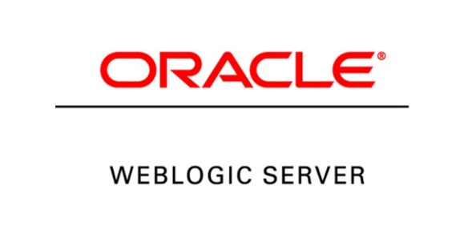
Application servers
implementation of all features in the Java EE specification, the most used being:
Java API for RESTful Web Services (JAX-RS)
Java API for WebSocket (WebSocket)
Enterprise JavaBeans (EJB)
Java Transaction API (JTA)
Java Persistence API (JPA)
Bean Validation
Contexts and Dependency Injection for the Java EE Platform
include a web container

Slide 15
servlets
receive and respond to requests from the end user
run within a web container
the web container deploys the Servlet with the application
HTTP is the only supported Servlet protocol
Servlet official API documentation

Slide 16
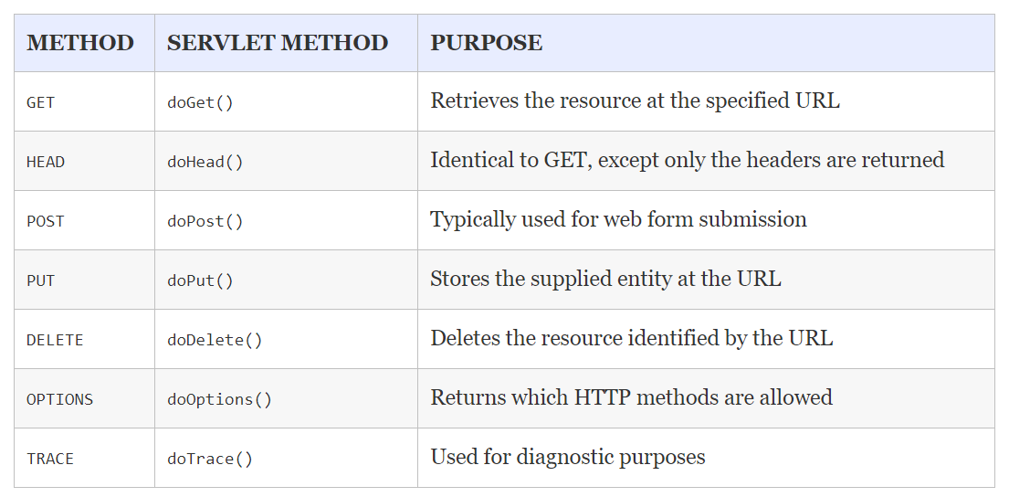
servlets

Slide 17
bibliography
Professional Java for Web Applications, chapters 1 - 7
HTTP: The Definitive Guide

Slide 18
THANK YOU
DANIELA CIUPERCA

